Slide 1
AMBEDKAR AND SOCIAL JUSTICE Represented By Anindita Chatterjee Full Name Baba saheb bhimrao ramji AmbedkaR (14th April 1891-6th December 1956 )

Slide 2
LIST OF BOOKS WRITTEN BY B R AMBEDKAR
STATE AND MINORITIES (1947)
WHO WERE THE SHUDRAS (1948)
THE UNTOUCHABLES (1948)

Slide 3
EVOLUTION OF SOCIAL JUSTICE
IN ROMAN GREEK TRADITION IT WAS CICERO WHO ELABORATED THE CONCEPT OF SOCIAL JUSTICE WHEN HE DECLARED WE ARE BORN FOR JUSTICE.

Slide 4
DIFFERENT THEORIES OF SOCIAL JUSTICE
THE TERM SOCIAL JUSTICE IS QUITE COMPREHENSIVE.SOCIAL JUSTICE IS A BUNDLE OF RIGHTS.IT IS A BALANCING WHEEL BETWEEN HAVES AND HAVE NOTS.

Slide 5
AMBEDKAR’S VISION
ACCORDING TO AMBEDKAR THE TERM SOCIAL JUSTICE IS BASED UPON EQUALITY LIBERTY FRATERNITY OF ALL HUMAN BEINGS.
JUSTICE
LIBERTY EQUAILITY FATERNITY

Slide 6
BASIC PRINCIPLES OF SOCIAL JUSTICE BY B R AMBEDKAR
ESTABLISHMENT OF SOCIETY BASED ON LIBERTY EQUALITY FATERNITY
ESTABLISHING DEMOCRACY POLITICAL ECONOMIC AND SOCIAL.
ESTABLISHING DEMOCRACY THROUGH CONSTITUTIONAL MEASURES.

Slide 7
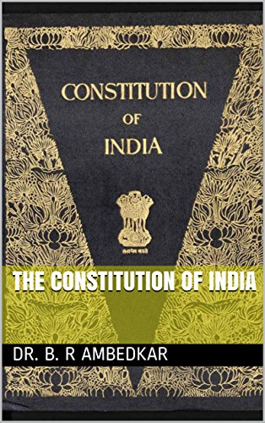
REFLECTION OF AMBEDKARS SOCIAL JUSTICE THROUGH THE CONSTITUATION OF INDIA
THE PREAMBLE OF INDIAN CONSTITUATION IS THE MIRROR OF SOCIAL JUSTICE.THE WORD CONTAINED IN THE PREAMBLE.
JUSTICE SOCIAL ECONOMIC AND POLITICALFATERNITY EQUALITY OF STATUS.
PART THREE OF THE CONSTITUATION RELATING THE FUNDAMENTAL RIGHTS CONTAINS THE THEME OF SOCIAL JUSTICE.

